Slide 1

Team Based Model of Care
Pandemic Response
2020/2021
Professional practice and Education Department
April 20, 2020

Slide 2
Objective for this presentation
To provide guidelines on how to utilize the entire workforce to support each other, optimizing the skills of clinicians and highly trained acute care staff with other staff that can serve in various support roles
This process is to support the higher demand for patient care outside of the typical primary care nursing framework only to be used in the event of an emergency

Slide 3
When to use model of Care
Design
When Acute and/or Critical care beds reach capacity limits, alternative physical areas will be considered depending on the level of surge response that is required.
Mackenzie Health has a well-defined and a systematic surge plan to address this, however, if there is a rapid increase in admission or decrease in staff availability, Team based model of care may need to be initiated in different parts of the hospital.
When Staffing of units becomes difficult due to variable situations (illness, surge)
When deemed necessary by leadership
The model is designed to maintain a safe care of patients even when specialized staffing resources are low.
Design

Slide 4

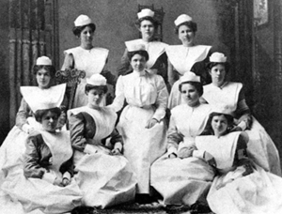
Team Based Model of Care
Team based nursing was a concept developed in the 1950s. There was
satisfaction from staff because the model allowed for a mix of experienced
practitioners with less experienced collectively sharing the tasks of patient care.
Experienced/Advanced
Team Leader
Team member
Support roles
Team member

Slide 5
Team Based Model of Care
Team based model of care will allow safe care for greater number of patients utilizing defined roles and responsibilities within the team
Success factors of a team:
Strong clinical skill mix
Good communication & decision-making skills
Cooperative working environment
All clinical programs, Allied health, clinical and non-clinical support services and physicians have developed a plan utilizing the concept of team based model of care to respond to the demand

Slide 6
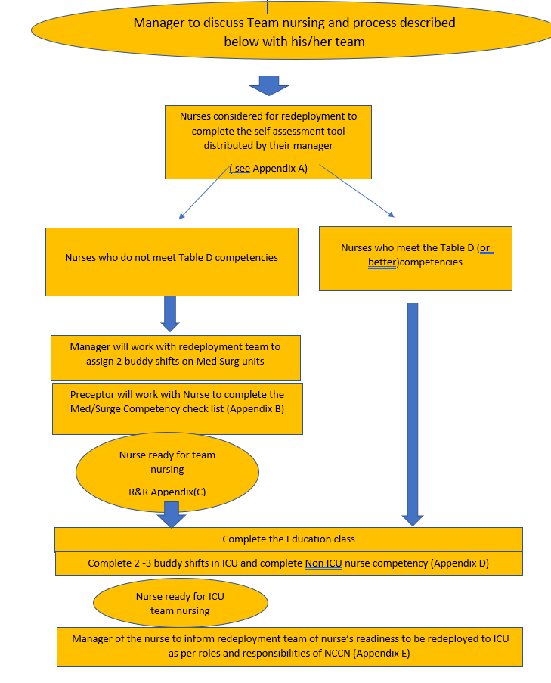
Process for integrating nurses into Acute & Critical care

Slide 7
On line Education module for upskilling
There is now a 2.5 hour education module in our “My learning”
All nurses will benefit from completing this module as it is a review on how to care for Covid-19 patients
This module has particularly been designed for nurses(RN & RPN) who will be going to Critical care units to work with the Critical care nurses in a team based model of care
It is recommended for this module to be completed prior to or during the 1st buddy shift in Critical care department
The module can be done on the nurses’ home unit, or at the library if no computer available on the unit

Slide 8
There are 10 topics within the online module on Upskilling Nurses to the ICU:
Team based model of care
ICU model of care
Nursing care for a patient with COVID-19
Respiratory care for COVID-19 patient
IPAC ICU
Protected code blue
Ventilator- Associated pneumonia and Oral care
Promoting Nutrition in the ICU
ICU sepsis
Handling of the deceased patient with COVID-19

Slide 9
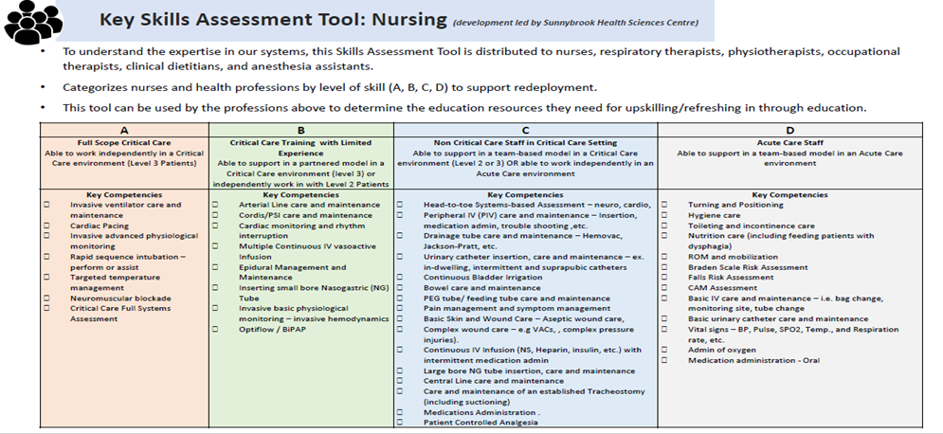
Assessment tool

Slide 10
Model of Care- Non critical care IP units (ie. Med/surg)
Supported by MD/RT/PT/OT/SW/Dietitian/SLP/Pharmacist/Educator/Manager as per Surge plan for allied health and physicians
Each inpatient unit will comprise of two or more care teams pending number of patients ( approximately 12-14 patients per 1 team)
PCA group may contain non PSW staff members from redeployment centre

Slide 11

Med/Surg Team-MRN Role
Review staffing, making the assignments; defining which tasks need to be done by RN/RPN and Non-Med Surg nurse based on the competencies The main contact for patient flow and assign beds for admissions Complete IPAC surveillance, Narcotic count Coordinate and plan for admissions and discharges Attends action round on behalf of all nurses Connect with nurses throughout the day to assist with workload/flow Assist in settling patient upon admission and report off to the team patient assigned to Initiate RM&R Work in collaboration with social worker and other interdisciplinary team for plan of care / discharge Oversee patients that are declining and becoming more acute and re assign task to nurses to accommodate Safety leader during a code Ensure daily huddle with all nurses at predetermined time, including weekends Ensure there are always at least 3 or more nurses on the unit and break coverage Email PCM the end of the shift report including the following SAFE content: Safety: any patient/staff incidences, any emergency codes Access: Unit census, number of admissions/discharges (including AMA & Death) Financial health: unplanned absences (including sick calls or emergency leaves; any sitters on the unit) Experience: any patient/family/staff concerns

Slide 12
Med/Surg Team-RN/RPN Role
Receive TOA from previous team Prioritize Assessment Attend to patients together or alone to complete their assessments/nursing tasks Carrying out orders and treatment plans within scope of practice, knowledge and capabilities Communicate frequently with each other to re prioritize and tasks as acuity and demands change Check in with Team leader with updates on a frequent basis Supervise PCAs if performing ADLs for patients Provide coverage for each other on breaks in consultation with MRN Document the care provided

Slide 13

Med/Surg Team-PCA Role
Answer call bells
Assist with setting up for meals and feeding
Assisting nurses during ADLs
Runners for supplies, getting blood, PPE as needed
Assist Regulated Health Care staff in transferring patients to and from bed
Restocking WOWs and carts
Assisting patients with making phone calls to family members/ setting up their tv/internet
Other duties as assigned

Slide 14
Team based model of care in other parts of the hospital
The model can be applied in all areas of the hospital as needed
Roles and responsibilities for the team members will be shared with the team on those units; ie in Woman and child program:
Specific roles and responsibility for peri natal nurse vs. the non perinatal nurse roles and responsibilities will be shared
Documentation to be reviewed with the manager as well

Slide 15
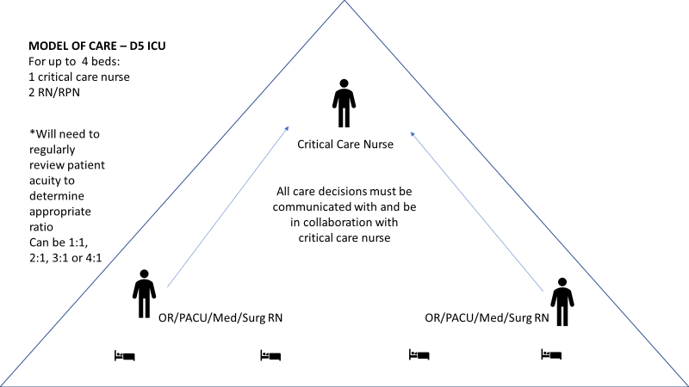
Model of Care- ICU
Supported by MD/RT/PT/OT/SW/Dietitian/SLP/Pharmacist/Educator/Manager as per Surge plan for allied health and physicians

Slide 16
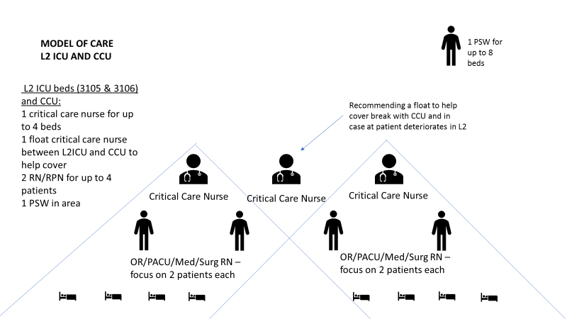
Model of Care- L2ICU beds
Supported by MD/RT/PT/OT/SW/Dietitian/SLP/Pharmacist/Educator/Manager as per Surge plan for allied health and physicians

Slide 17
ICU Team- Critical Care Nurse
Be present for shift report & rounds
Be in constant communication with other members of team about changes to patient’s status, plan of care, etc.
Patient assessment & documentation
  Document ventilator settings
  TGLN assessment (GIFT criteria) and documentation
  Sedation scoring (MAAS)
Critical Care medication administration & monitoring
  Inotropes, sedatives, anti-arrhythmics
  Hanging & mixing of critical care infusions
  Documentation of initiation, titrations and patient’s response to changes
Hemodynamic monitoring
  Initiation, titration & discontinuing of all critical care infusions (e.g.: norepinephrine, vasopressin, epinephrine, dopamine, dobutamine, fentanyl, midazolam, morphine, hydromorphone, propofol, cisatracurium, amiodarone, diltiazem)
Anything to do with the ventilator
  Inline suctioning
  Acknowledging vent alarms

Slide 18
ICU Team- Critical Care Nurse
Monitor alarms
  The ONLY one who can silence the alarm – all non-critical care nurses must let critical care nurse know about alarms
Relieve another critical care RN for breaks
Be involved in as required with positioning of stable critical care patients, participate in repositioning when patients are unstable or have many lines/drains
**Can be shared with OR/PACU/med nurses:
  Assisting MD with bedside procedures, central line & arterial line management
  POCT glucose
  Calling TGLN
Interpretation of and following-up with blood work results
  Use of critical care electrolyte protocol
  Sign & Held order for low hemoglobin
  Can work with other nurses for heparin protocol
  Runner as needed
  Notify MD of concerns

Slide 19
ICU Team- Non- Critical Care Nurse
Be present for shift report & rounds
Be in constant communication with other members of team about changes to patient’s status, plan of care, etc.
Patient assessment & documentation
  Document vital signs, head-to-toe assessment, daily care (turning, oral care/peri care), IV assessment
  Document as close in time as possible to when care was provided to patient
  Head to toe assessment at beginning of shift, continued or focused assessment every 4 hours and re-assessment after any interventions
  Hourly intake & output, vitals as ordered, restraints (if used)
Patient care – mouth care, oral suctioning with yankauer, skin care, reposition patient with critical care RN to support in relation to patient acuity
Runner as needed
Notify critical care RN of any acute changes in patient’s status AFTER doing a quick assessment of the patient
  Changes in heart rate: faster or slower than before OR changes to cardiac rhythm (if able to interpret)
  Changes in respiratory rate or respiratory effort: faster or slower rate, laboured breathing, increased work of breathing, short of breath
  Higher or lower BP than previous (will need to discuss with critical care RN which set of numbers they need to be aware of depending on if arterial line is accurate to NIBP or not)
  Desaturation: AFTER verifying that probe is on patient properly and oxygen is on patient as well
  Note hourly urine output: notify if there’s change in volume of output over last 4 hours OR if there’s a been a change in colour or consistency (turned red, more sediments, etc)
  All orders must be reviewed by the Critical Care Nurse for ICU team-based model

Slide 20
ICU Team- Non- Critical Care Nurse-continued
  Any signs of bleeding from anywhere
  Patient gagging on endotracheal tube
  Change in colour of patient or in any limb
  If any alarms on physiological monitor or ventilator are going off
Medication administration with knowledge, skill & judgment – if unsure, PLEASE ask critical care RN
  Can provide independent double check for medications that are within their scope of practice (ie: insulin sliding scale, heparin SC)
Top up feeds/flushes as appropriate
Notify critical care RN if infusions are within 2 hours of finishing
Assist with obtaining blood work – peripheral venipuncture, from central line or arterial line (within knowledge, skill & judgment)
Simple dressing changes
Assist with procedures (if able to based on knowledge, skill & judgment)
Relieve another non-critical care nurse for break
POCT glucose

Slide 21

Documentation
All Regulated Health Care Professionals must document care provided, assessments and findings in the appropriate EPIC application
Notes, Vital sign flow sheet and MAR are accessible and visible in all Epic applications
Ensuring that documentation is completed by the individual who performed the action or observed the event, except when there is a designated recorder, who must sign and indicate the circumstances (i.e. during team-based model of care during pandemic time- similar idea as during a code)

Slide 22
Note Documentation In EPIC on Med/Surg areas (Exclude specialty units)
When the total number of patient per team exceeds time needed to document all of the organization standard requirement, Regulated health care professionals may be directed to do condensed documentation
Manager/ Delegate to determine when to start the team-based model of care documentation
Communication needs to be sent out to all departments to inform everyone of the pandemic documentation initiation
Nurses can start this documentation in the new progress note by entering the word “pandemic”, then select “PANDEMICNURSENOTE”. This will launch SmartText with Disclaimer for team-based model of care documentation and SOAP(Subjective/Objective/Assessment/Plan) charting guide.
Vital sign/MAR/ Nutrition/ I&O/Lines Workflows and Height/ Weight/Allergy, always remain as mandatory fields for documentation
All staff are encouraged to complete all the required documentation as much as possible and only refer to the altered/condensed documentation under strenuous circumstances when initiated by management

Slide 23
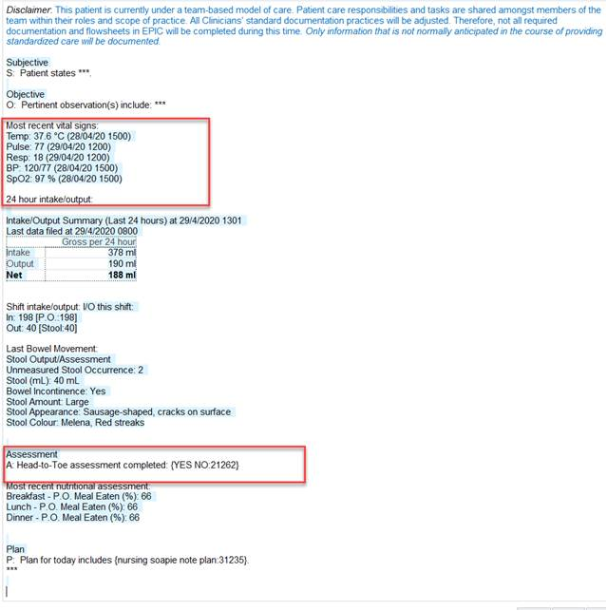
Note Documentation In EPIC on Med/Surg areas (Exclude specialty units)

Slide 24
Questions...
Please feel free to contact one of the members of the Professional Practice and Education Department as listed below if you have any further questions
Linda Gravel X 7265
Jackie Samimi X 3077
Angela Chan X 7461

