Slide 1
BASIC ECG INTERPRETATION
&
RECOGNIZING STEMI
october 2020

Slide 2
Objectives
Understand the purpose of a standard 12-lead ECG
Understand how the ECG is created using electrical signals
Understand what a 15-lead and right-sided ECG are used for, and how to perform them
Perform basic interpretation of ECG for emergent concerns
Recognize ST elevation on an ECG
Understand appropriate reporting process to initiate CODE STEMI in ER
To understand nursing duties/care for patient with STEMI
To understand transfer process for patient with STEMI

Slide 3
PRE-REQUISITES/CO-REQUISITES
Refer to other PRH Critical Care modules:
Prerequisite Module
  Cardiac Monitoring and Interpretation (rhythm interpretation is not discussed here)
Co-requisite Module
  Performing an ECG (performance is not discussed here)

Slide 4
Anatomy & Physiology Refresher

Slide 5
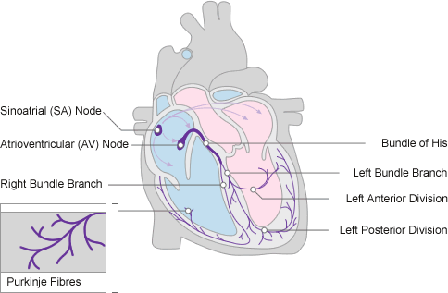

Electrical Conduction Pathway
During each heartbeat, a healthy heart has an orderly progression of depolarization
pacemaker cells in the sinoatrial node (SA)
spreads out through the atrium
passes through the atrioventricular node (AV)
down into the bundle of His
into the Purkinje fibers
spreading down and to the left throughout the ventricles
This orderly pattern of depolarization gives rise to the characteristic ECG tracing.

Slide 6
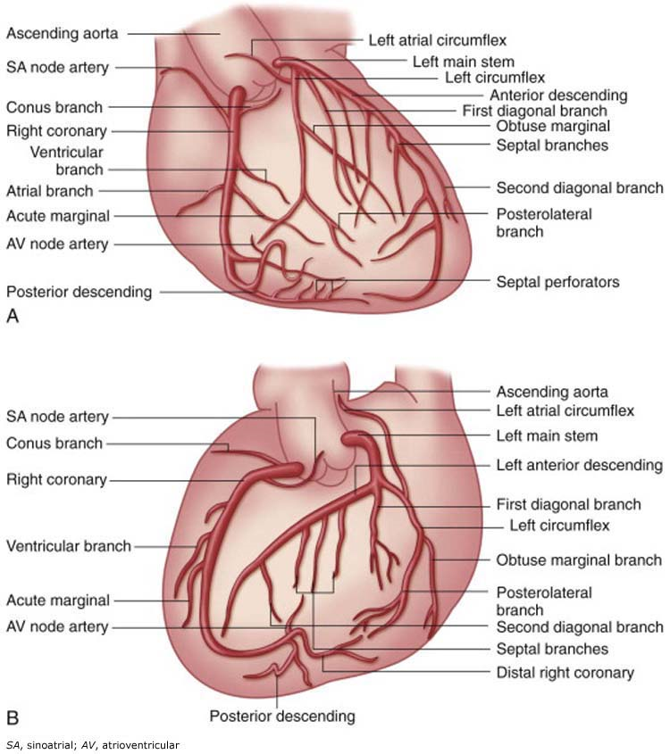
coronary
vessels
Coronary vessels:
A – Anterior oblique
B – Left anterior oblique
The major arteries are:
Left main
Left anterior descending (LAD)
Left circumflex (LCX)
Right coronary arteries (RCA)
Notes:
These are the vessels that provide blood TO the heart (not through the heart). When a person has CAD – these are the arteries that are affected (atherosclerosed = plaques). These are the arteries responsible for providing O2 to the heart.
Because we know which areas of the heart these vessels supply, we can look in these areas on the ECG (anterior, inferior, lateral, posterior, right side)
Discussion:
What happens when the heart doesn’t get enough O2? → chest pain/angina
What is the different between angina and MI?
Think about why nitroglycerin is effective?

Slide 7
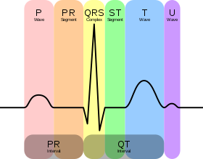
Electrocardiography
Electrocardiography (ECG) is the process of recording the electrical activity of the heart over a period of time using electrodes placed on the skin.
Notes:
These electrodes detect the tiny electrical changes on the skin that arise from the heart muscle’s electro-physiologic pattern of depolarizing and repolarizing during each heartbeat.

Slide 8
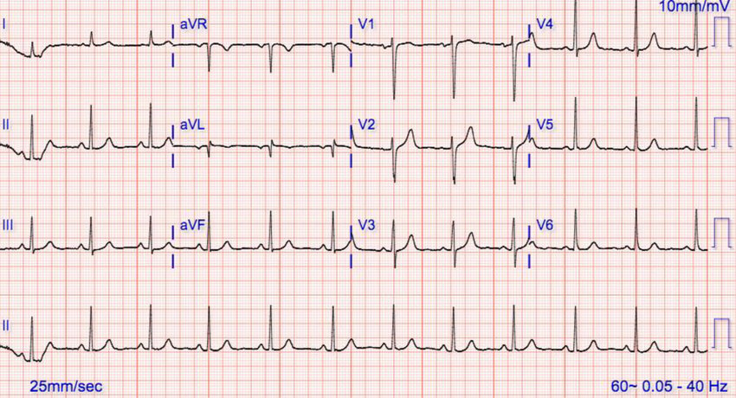
A standard 12-lead ECG
Notes:
What are we looking at?
A snapshot of 12 different views of the heart taken simultaneously.
Shown in 4 columns with 3 in each column.
Usually 1 or 2 rows of continuous strips underneath.
Typical ECG strip rate is calculated on 6 seconds. If you want to roughly estimate the rate of the heart (without officially counting), on the continuous strip, count the number of QRS that occur in the first 2.5 columns worth, then multiply by 10.
What would the approximate heart rate be here?

Slide 9
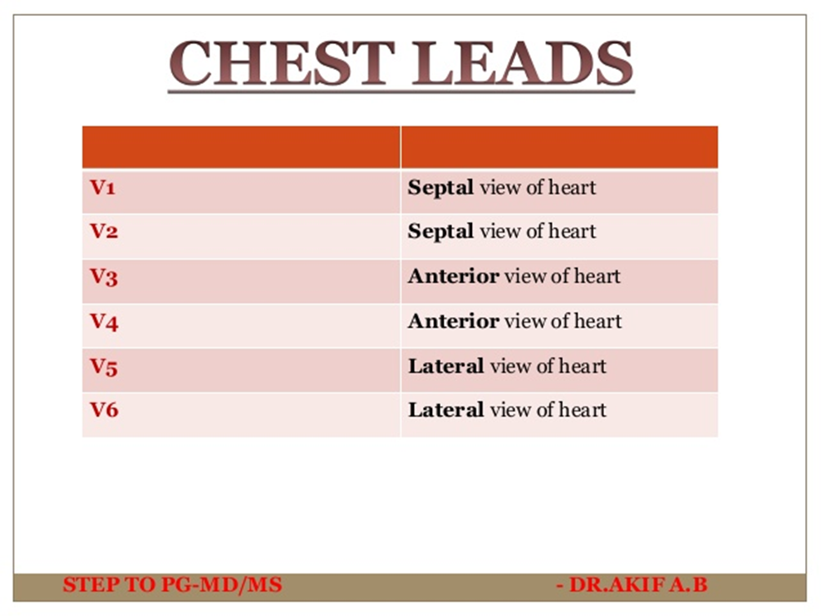
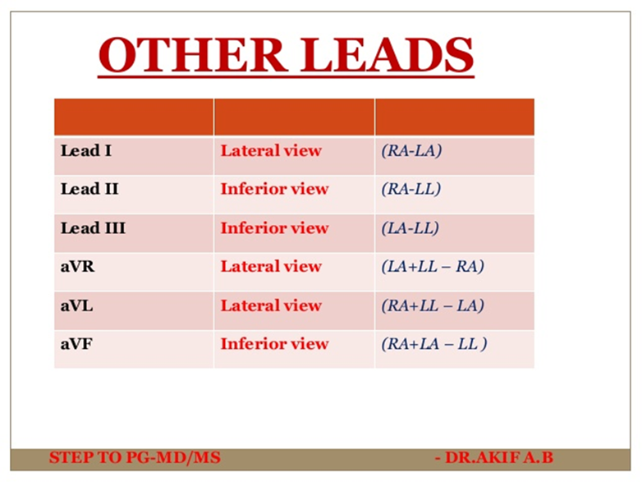
Why so many leads?
(They all look at a different angle of the heart)
Chest Leads/Precordial Leads
Limb Leads
Notes:
The augmented limb leads are formed through mathematical calculations without adding anymore physical electrodes. For example, aVR = RA – ½ (LA + LL)
This is how we get 12 views with only 10 leads
Keep in mind that RL is neutral (also known as point zero where the electrical current is measured). RL doesn’t come up in ECG readings, and is considered as a grounding lead that helps minimize ECG artifact. --- original leads eg. LA, LL, RA, 3 wires
Minus RL = 9 leads, 9 + 3 = 12
Don’t call all of the wires “leads” this is technically inaccurate. For the chest leads, the wires and leads are the same, but for the limb leads it is different. For example, you can’t say Lead II = Right Arm wire, because it isn’t true.
Think of the leads being “views” and the wires being wires may help avoid confusion.

Slide 10
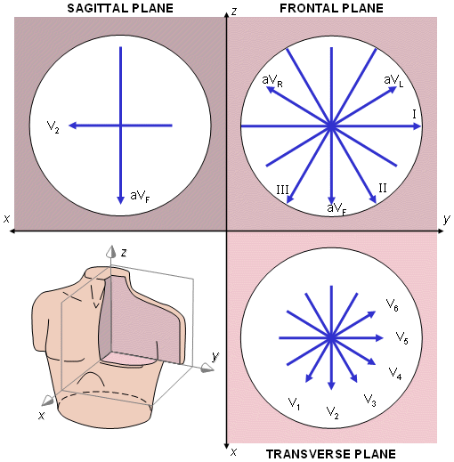
12-lead ECG – the views
This is showing that simultaneously, the 12-lead ECG can show us a snapshot picture as if looking:
  Transverse
  Frontal
  Sagittal
That’s a lot of information about the heart all at once!

Slide 11
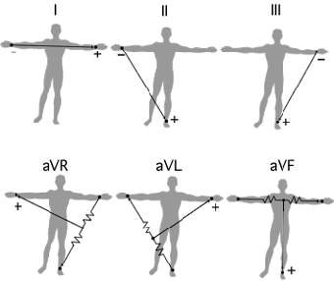
How come on the crash cart there are only 3 wires?
Eintoven’s Triangle
All of this started with just 3 leads – I, II, III
Notes:
In an emergency, using these 3 leads will give you 6 separate views of the heart (half as much as an ECG!! But these views are all on the vertical/frontal plane – none of them are on the transverse plane). Not as diagnostic as a full 12-lead, nor as good as 5 wire telemetry, which includes
Again note there is no RL as this is a grounding lead and isn’t necessary
We get inflections (positive or negative) depending on whether or not we are moving towards or away from the positive electrode.
Note that when referring to the LIMB leads, a “wire” isn’t the same as the lead (what it is looking at)
So, if you’re looking at your patient’s waveforms on the monitor and you see that lead I and II have artifact but lead III is okay, you know it’s a problem with the left arm probe. (Process of elimination).

Slide 12
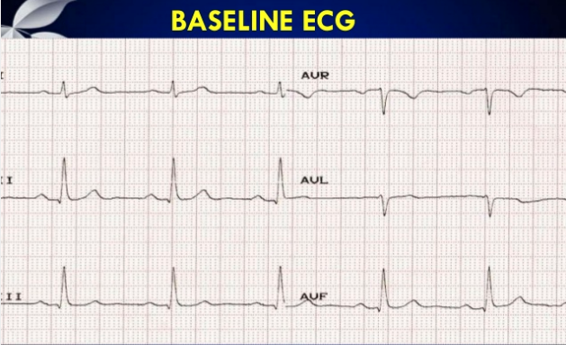
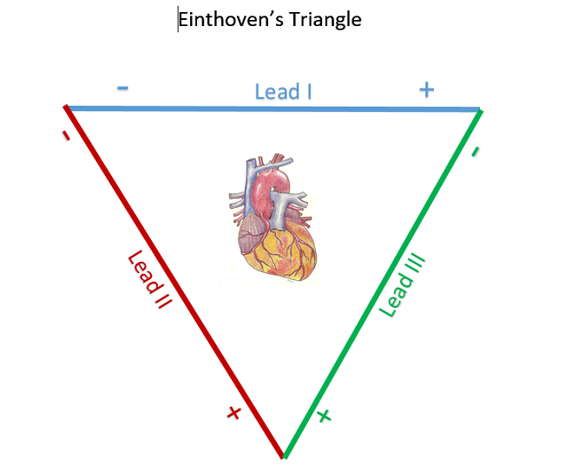
Does electrode placement matter?
Placement of the electrodes is very important to ensure consistency between tracings
What if placement is not the same?
Often, the left and right arms are mistakenly switched.
Correct placement, normal ECG
RA
LA
RA
LA
LL
LL
Notes:
Placement of the electrodes is very important to ensure consistency between tracings. One suggestion is to mark landmarks for electrodes with permanent marker to ensure consistent placement.
What if placement is not the same? This can affect the readout and in the case of 12-lead ECGs, it can lead to misdiagnosis.
For example, we can use Eintoven’s triangle to identify incorrect lead placement. “If the arm electrodes are reversed, lead I changes polarity, causing lead II and lead III to switch. If the right arm electrode is reversed with the leg's electrode, lead II changes polarity, causing lead I to become lead III, and vice versa. Reversal of the left arm and leg causes a change in polarity of lead III and switching of leads I and II”
https://en.wikipedia.org/wiki/Einthoven%27s_triangle#:~:text=Einthoven's%20triangle%20is%20an%20imaginary,Einthoven%2C%20who%20theorized%20its%20existence.

Slide 13
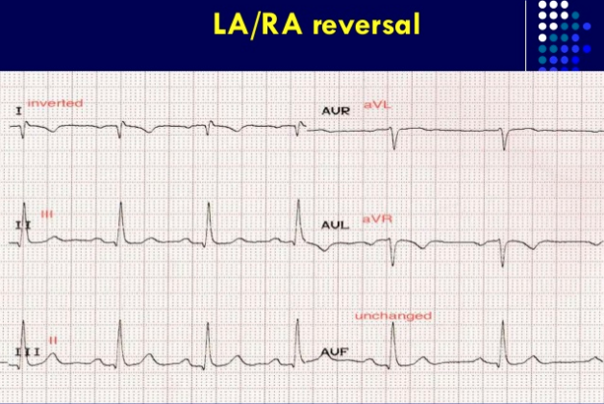
Does placement matter? Yes!
Note that if RA and LA are switched, it causes major changes to the ECG tracing. This is become limb polarity is switched.
Lead I is inverted.
Lead II becomes lead III.
Lead III becomes lead II.
Lead aVR becomes aVL.
Lead aVL becomes aVR.
Notes:
Placement of the electrodes is very important to ensure consistency between tracings. One suggestion is to mark landmarks for electrodes with permanent marker to ensure consistent placement.
What if placement is not the same? This can affect the readout and in the case of 12-lead ECGs, it can lead to misdiagnosis.
For example, we can use Eintoven’s triangle to identify incorrect lead placement. “If the arm electrodes are reversed, lead I changes polarity, causing lead II and lead III to switch. If the right arm electrode is reversed with the leg's electrode, lead II changes polarity, causing lead I to become lead III, and vice versa. Reversal of the left arm and leg causes a change in polarity of lead III and switching of leads I and II”
https://en.wikipedia.org/wiki/Einthoven%27s_triangle#:~:text=Einthoven's%20triangle%20is%20an%20imaginary,Einthoven%2C%20who%20theorized%20its%20existence.
https://www.slideshare.net/PraveenNagula/ecg-limb-lead-reversal

Slide 14
Lead I is your major clue.
All of the waveform is inverted.
If you see an inverted P and an inverted T together, suspect limb (RA & LA) lead reversal
Check to see that leads were applied correctly
Take home message = lead placement impacts the rhythm strip!
This is true for any electrode placement – placement should be consistent from nurse to nurse
Consider marking with a dot in permanent marker
Notes:
Inverted P waves (junctional) --- but T wave is upright, unless ischemia. Double check PR interval if less than 0.12 = junctional; if 0.12-0.20 = normal, more likely limb reversal
Inverted T waves (ischemia) --- but P wave is upright
It is important to place electrodes in the correct positions. Many ECG technicians rely on their experience, but that is not reliable. Electrode placement affects the reliability of the ECG, and care must be taken to place them properly. For example, if the limb leads are improperly placed on the chest, this must be noted on the ECG strip, because chest placement of limb leads can affect the tracing, which is important for the physicians interpreting the strip to know. If you change the position of limb leads or any other leads, this must also be written on the strip. Patterns can change if the patient's position is changed between ECGs. For example, moving the patient from a supine to a seated position can cause the tracings to look somewhat different. If the patient's position changed, note that on the strip for the interpreting physician ----https://www.emsworld.com/article/10321209/recognition-and-treatment-right-ventricular-myocardial-infarction#:~:text=The%20traditional%20field%20treatment%20for,often%20referred%20to%20as%20MONA).

Slide 15
Types of ECGs

Slide 16
Why order an ECG?
ECG is a diagnosing and investigative tool
ECG can be used to show the MD or cardiologist the following:
  Enlargement of the heart (RA, RV, LA, LV hypertrophy)
  Abnormal rhythm (arrhythmia) – rapid, slow or irregular heart beats
  Damage to the heart such as when one of the heart’s arteries is blocked (coronary occlusion) (STEMI)
  Poor blood supply to the heart (ischemia)
  Abnormal position of the heart (axis deviation)
  Heart inflammation – pericarditis or myocarditis
  Disturbances of the heart’s conducting system (e.g. blocks)
  Imbalances in the blood chemicals (electrolytes) that control heart activity (e.g. hyperkalemia and others)
  Previous heart attacks (Q waves)
Many uses… ECG expertise takes years of specialty training
Here we are focusing on ST changes

Slide 17
3 main types:
Type | What is it looking for?
Standard 12-Lead | Looks at ANTERIOR, INFERIOR, LATERAL portions of heart Only one lead (V1) looks at the right side – not good for right side infarcts Does not look at the posterior
15-lead ECG | Standard 12-lead ECG views PLUS V4R (right side) – now there are two leads looking at right side (V1 and V4R) V7 (optional), V8, V9 – looks at POSTERIOR
Right-sided ECG | To fully assess the RIGHT side. All chest leads are moved to right side (V1R-V6R)

Slide 18
Recognizing ST Segment Changes
Notes:
Represent ischemia or infarction.

Slide 19
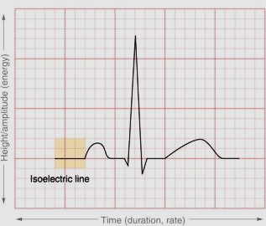
The J-point and isoelectric line
In between electrical activity, the rhythm should return to the “isoelectric line”
Pay attention to the J point, where the S wave ends
This is where you look for ST changes (elevation or depression)
J point

Slide 20
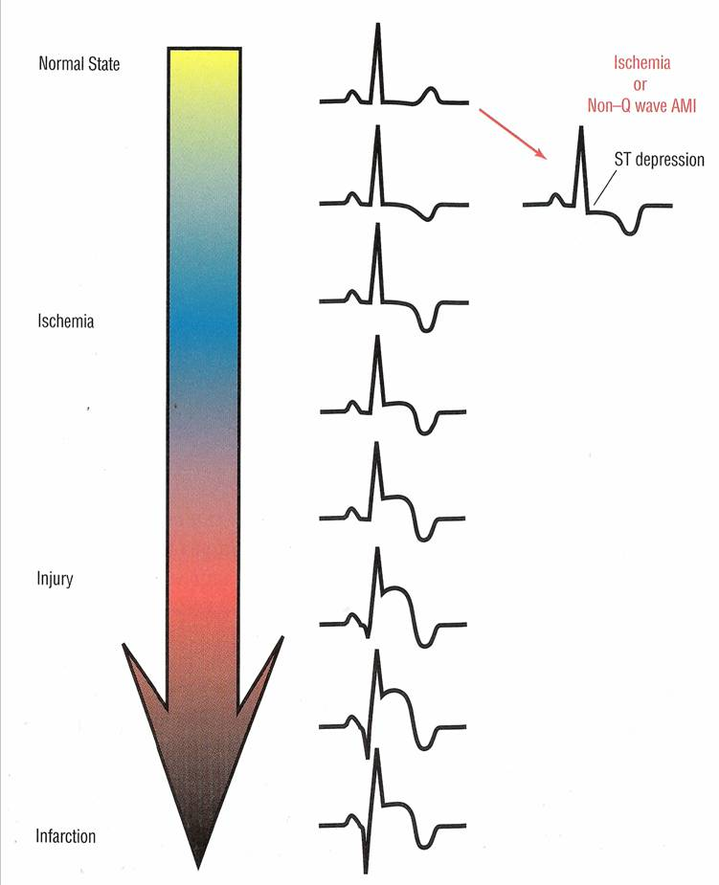
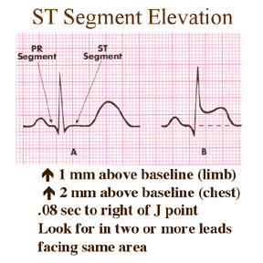

Notes:
MUST BE AT LEAST 2 SMALL BOXES IN CHEST LEADS (2MM)
AT LEAST 1 BOX IN LIMB LEADS (1MM)
IMAGE DEPICTING PROGRESSIVE ST CHANGES
20

Slide 21
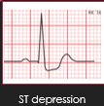
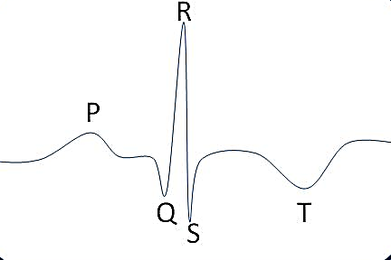
Reminder:
ST Depression vs Inverted T wave
inverted T wave
Inverted T waves represent ischemia
ST depression also represents ischemia, but may also be reciprocal changes (opposite) to the area of an ST elevation infarct. If ST depression is seen, note the area (which leads), look for ST elevation and consider the need for a 15-lead ECG or right-sided ECG

Slide 22
Which areas relate to which part of the heart?
Notes:
Have students circle on their paper the boot/gun areas.

Slide 23
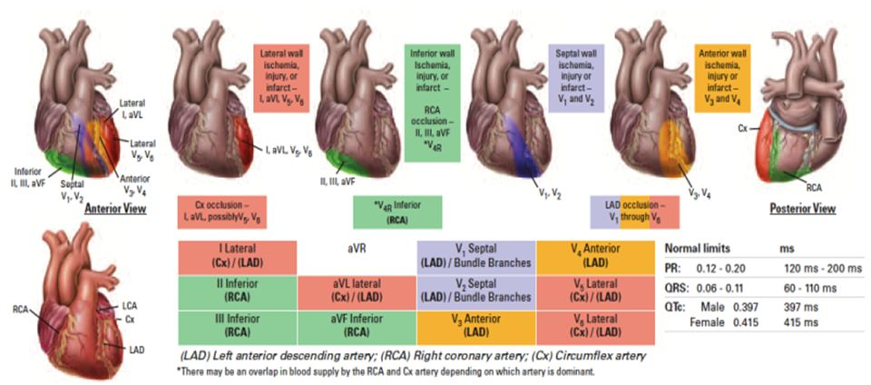
12-lead ECG
Notes:
Visualization of the areas of the heart impacted by infarction of the affected vessels.
How can we remember this?

Slide 24
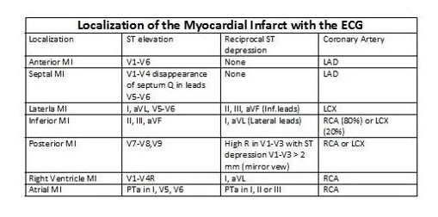
Determining Location of MI
Notes:
Coronary Artery = “Culprit” Artery – the one where the problem is
Don’t worry about Atrial MI too much
Atrial MI PTa= changes in the wave between P wave and Q wave
P-Ta elevation >0.5mm in V5 and V6 with reciprocal depression in V1 and V2
P-Ta elevation >0.5mm in I and depression in II and III
> 1.5mm P-Ta depression in precordial leads
> 1.2mm P-Ta depression in I,II or III in combination with atrial arrhytmias

Slide 25
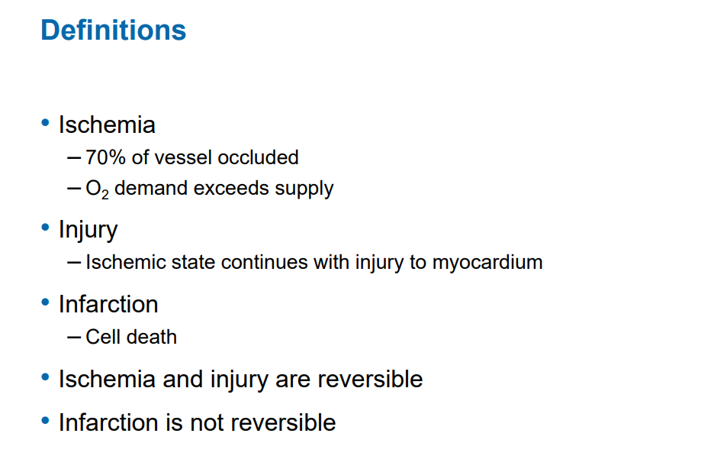
Notes:
http://www.clevelandclinicmeded.com/live/owork/US-State-2017/presentations-nurse/BRK%2011%20Klein%2012%20Lead%20ECG%20interpretation%20v2.pdf

Slide 26
Terms: Contiguous and Reciprocal
Term | Definition/Meaning
Contiguous
Reciprocal
Notes:
Have class fill in the blank during lesson
Contiguous means looks at the same area of the heart
Reciprocal is the area opposite of the infarction/ischemia

Slide 27
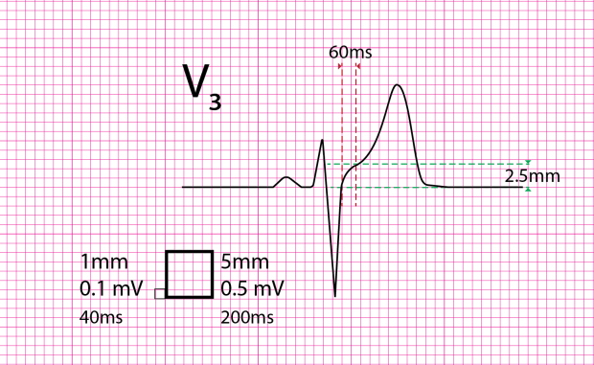
What’s the big deal with STEMI?
Code STEMI = ST segment Elevation Myocardial Infarction
Infarction = myocardial cellular death due to deprived of oxygen supply
Myocardial cell death = decreased heart function since cells are dying
Cell death is happening RIGHT NOW in a STEMI. If we can get blood flow back to the damaged area of the heart, we can decrease the damage!
Time is heart!
Notes:
It’s a big deal because these MIs are amenable to urgent treatment by PCI (percutaneous coronary intervention) at OHI; the goal is to get them there ASAP!!!
Inclusion criteria are symptom onset within last 12 hrs (symptoms suggestive of cardiac ischemia) and at least 1 mm of ST elevation on ECG in two contiguous leads
Examples of symptoms: chest, arm, jaw, back, neck pain with or without dizziness, nausea, SOB, diaphoresis

Slide 28

Code STEMI timeframe?
Time of onset is important to help determine if they are eligible for PCI
To meet criteria, onset must be within 12 hours
**In some circumstances, patients may be accepted for PCI outside of the 12-hour window**

Slide 29
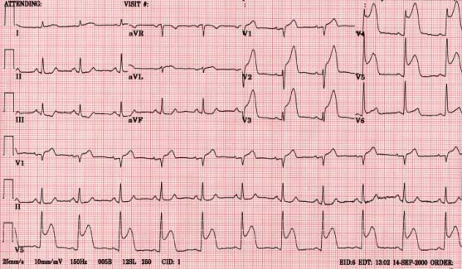
WHAT TYPE OF STEMI IS THIS?
Culprit artery:
LAD +
LCX
Notes:
Have students identify areas of ST elevation (infarction)
ANTEROLATERAL MI (MASSIVE MI) – THE WHOLE FRONT AND SIDE OF THE HEART
RECALL LV IS YOUR PUMPING POWERHOUSE – WHAT WILL RESULT? → LV FAILURE, CARDIOGENIC SHOCK, SEVERELY DECREASED CARDIAC OUTPUT, POSSIBLY ARRTHYMIAS
WHERE WAS THE CULPRIT ARTERY? LAD, YES, BUT THERE IS ALSO LATERAL INVOLVEMENT (LCX). THIS COULD HAVE BEEN A LEFT MAINSTEM INFARCT AKA = THE WIDOWMAKER

Slide 30
LOOK AT THIS IMAGE WHILE REFERRING TO PREVIOUS ECG
Look at how much of the heart is supplied by the LAD and LCX
The area of the ECG tells us where the blockage is, where the damage is occurring
Is this a minor or major MI?
Notes:
Anterolateral MI ---- LAD and LCX involvement

Slide 31
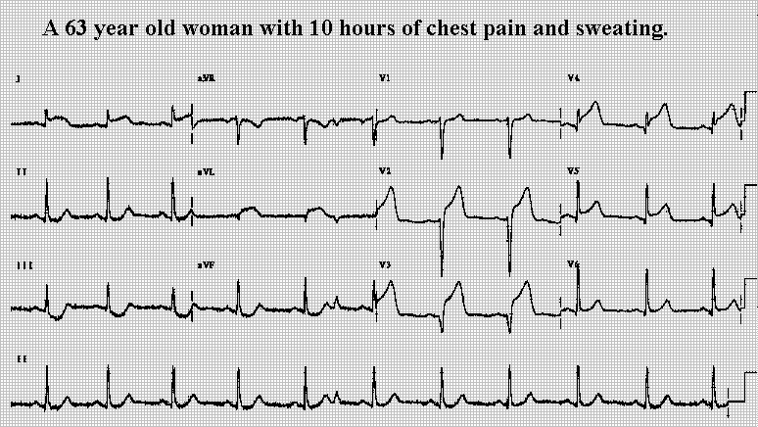
Notes:
Where is the elevation?
Where is the depression (reciprocal?)
Any other ST changes?
What type of infarction is this?
ANTEROLATERAL INFARCT – reciprocal changes starting in inferior

Slide 32
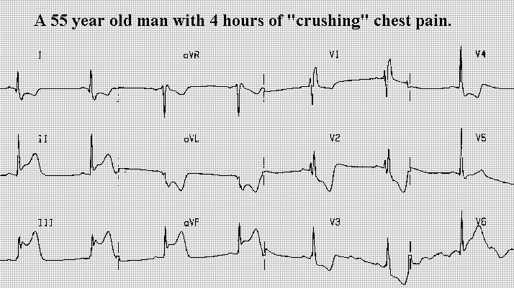
Notes:
Where is the elevation?
Where is the depression (reciprocal?)
Any other ST changes?
What type of infarction is this?
INFERIOR INFARCT – reciprocal changes starting in anterior
→ should consider 15-lead
(INFERIOR RARELY OCCUR ALONE, OFTEN WITH RV INFARCT OR POSTERIOR INFARCT)

Slide 33
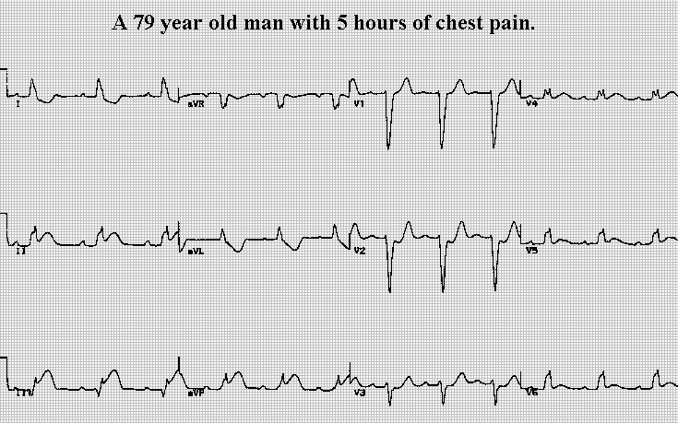
Notes:
Where is the elevation?
Where is the depression (reciprocal?)
Any other ST changes?
What type of infarction is this?
INFERIOR INFARCT – reciprocal changes starting in anterior (V2, V3)
→ should consider 15-lead
(INFERIOR RARELY OCCUR ALONE, OFTEN WITH RV INFARCT OR POSTERIOR INFARCT)
What else do you notice about this ECG? Look at the QRS complex?
LBBB – if new is a sign of MI (conduction changes in electrical pathway due to death of myocardium). Look up an old ECG in file/chart for comparison – if not available, treat as new.

Slide 34
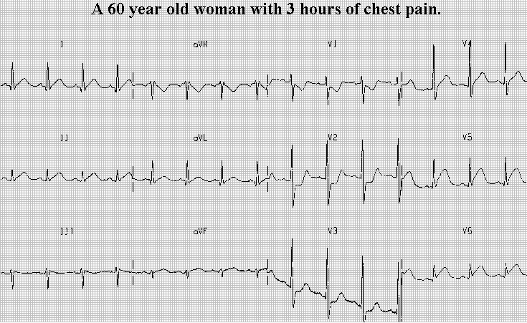
Notes:
Where is the elevation?
Where is the depression (reciprocal?)
Any other ST changes?
What type of infarction is this?
LATERAL– reciprocal changes starting in anterior (V1, V2)
→ should consider 15-lead → ELEVATION IS ALMOST EXCLUSIVELY TOWARDS THE POSTERIOR – double check that it isn’t extending into the posterior (V7, V8, V9)

Slide 35
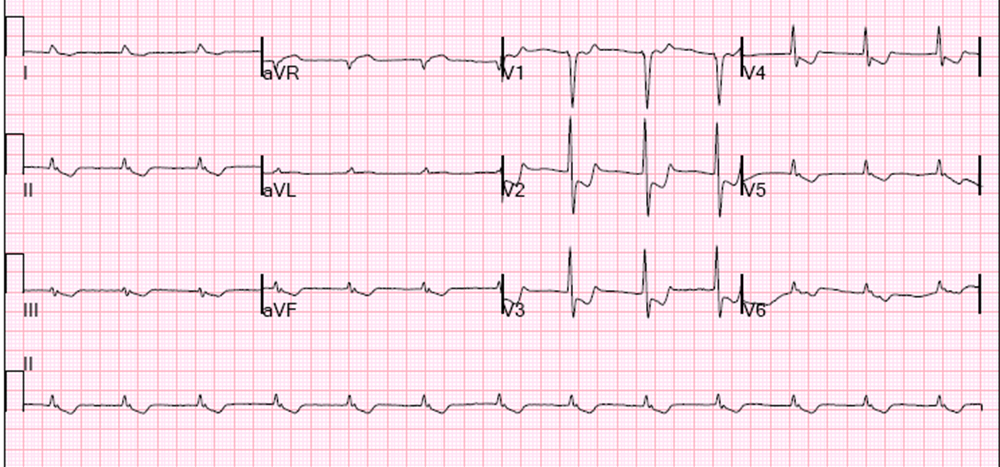
A STANDARD 12-LEAD THAT SHOULD TRIGGER A 15-LEAD ECG (POSTERIOR)
Notes:
Where is the elevation?
Are there any other ST abnormalities? (Flipped T wave inferior = ischemia)
Where is the depression? (reciprocal) → if this is opposite, where should we look for the problem?
REMEMBER, A 15-LEAD LOOKS AT THE POSTERIOR, BUT IT ALSO INCLUDES V4, ONE EXTRA LEAD LOOKING AT THE RV.
INFERIOR INFARCTS – rarely occur alone and are often associated with POSTERIOR MI
INFERIOR INFARCTS – are also often associated with RIGHT-SIDED INFARCT.
THE 15-LEAD can quickly see if there is elevation in the POSTERIOR (V7, V8, V9) OR in the RIGHT-SIDE (V1, V4R).

Slide 36
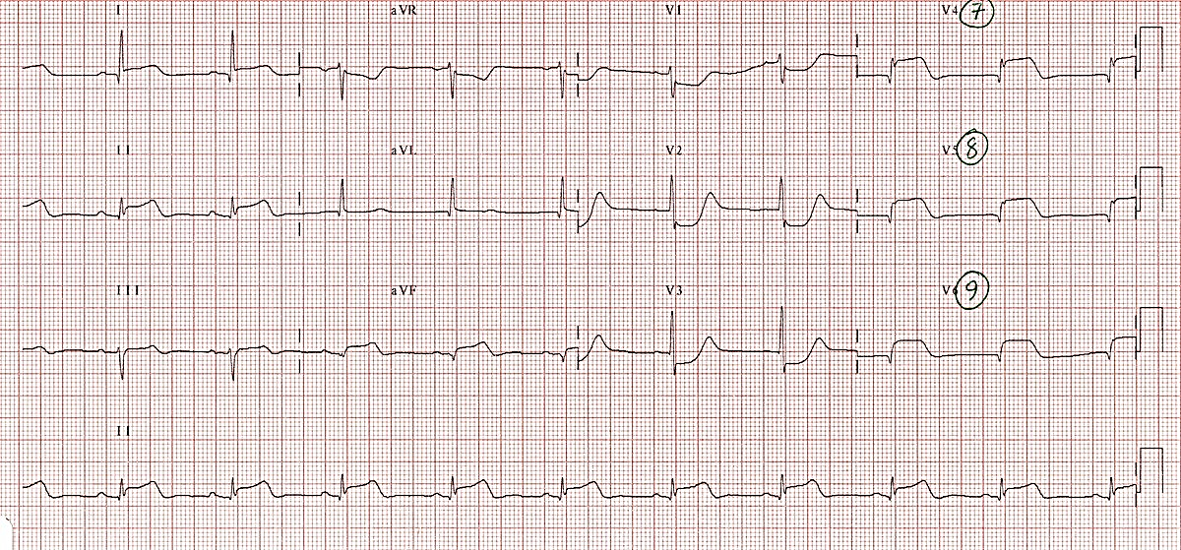
A 15-LEAD ECG -
V7, V8, V9 LOOK AT THE POSTERIOR
Notes:
This is a different ECG.
Where is the elevation?
Where is the depression – reciprocal?
What is this infarct called?

Slide 37
RIGHT SIDE INFARCTION
Notes:
RIGHT SIDE ECG

Slide 38
RIGHT-SIDED INFARCT
Suspect or rule out RV infarction in all patients with inferior STEMI!
Giving nitro to patients with an RV infarction is contraindicated as it can cause severe hypotension
Notes:
We have talked about how the standard 12-lead only has 1 lead looking at RV (V1) and a 15-lead has two leads (V1, V4R).
Right sided ECG is necessary when you want to see the full right side V1R- V6R. The most useful lead is V4R, which is obtained by placing the V4 electrode in the 5th right intercostal space in the midclavicular line.
ST elevation in V4R has a sensitivity of 88%, specificity of 78% and diagnostic accuracy of 83% in the diagnosis of RV MI. ST elevation in the right-sided leads is a transient phenomenon, lasting less than 10 hours in 50% of patients with RV infarction
Right ventricular infarction complicates up to 40% of inferior STEMIs.
Isolated RV infarction is extremely uncommon.

Slide 39
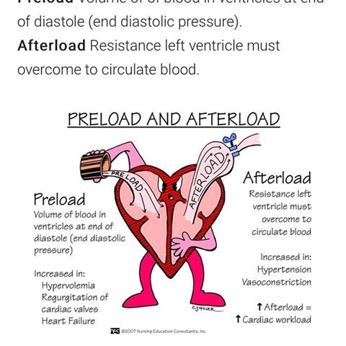
Right-sided MI
Preload dependent (due to poor RV contractility)
Can develop severe hypotension in response to nitrates or other preload-reducing agents
Severe hypotension in RVI is treated with fluid loading, and nitrates are contraindicated
Notes:
RVI patients are “preload” dependent.
Those with an RVI could need from 1 to 5 liters in the acute setting. Trial with 500ml may be necessary.
RVI needs the extra preload to recruit “Starling” forces on the right side. (the greater the stretch the greater the force of contraction = think like an elastic rubber band)
Vasodilators such as morphine and nitro can cause a profound drop in blood pressure, even arrest, in the patient with an RVI.
What other medication (not nitro/nitrates) that we give for MI should we give with caution as it can also reduce preload?
Morphine!

Slide 40
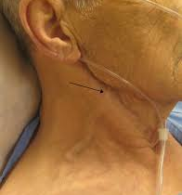
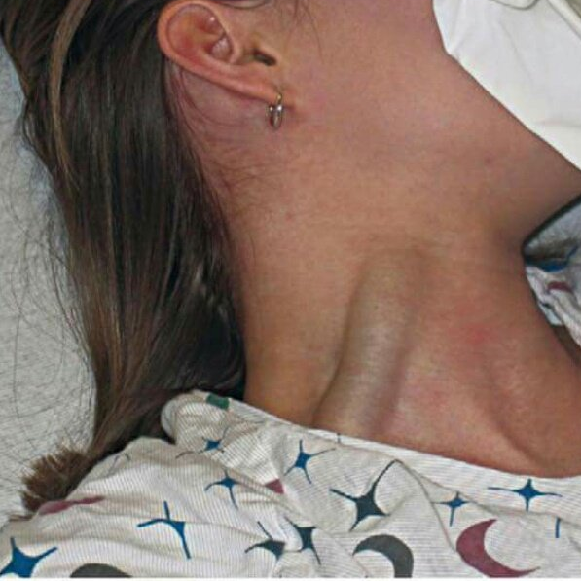
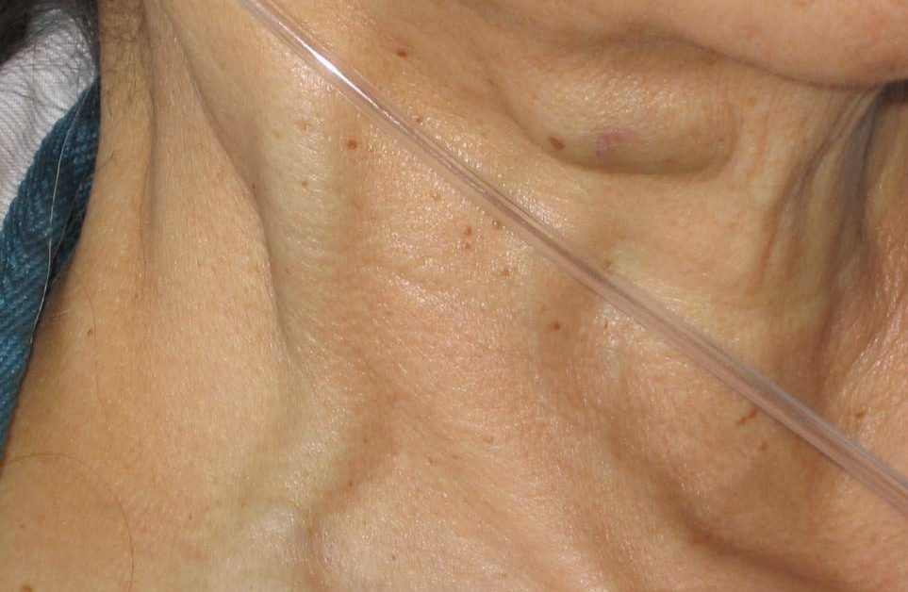
3 Clinical signs of RVI
The TRIAD:
Jugular vein distention (JVD)
Hypotension, either presenting or following nitro administration
Clear lung sounds
Notes:
JVD can be caused by other conditions but ensure you are looking for it in your ACS/chest pain/MI patients as part of your ROUTINE ASSESSMENT.
(middle image is actually of cardiac tamponade!)

Slide 41
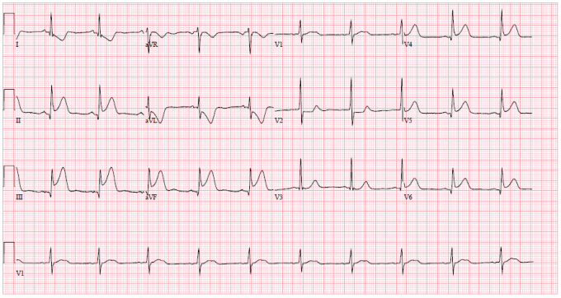
A STANDARD 12-LEAD THAT SHOULD TRIGGER A RIGHT-SIDED ECG
Look for elevation in V1 or isolectric V1 with ST depression V2
ST elevation lead III
more than lead II
Notes:
Where is the elevation?
Where is the depression (reciprocal?)
Any other ST changes?
What type of infarction is this?
INFEROLATERAL WITH POSSIBLE RV INVOLVEMENT
In patients presenting with inferior STEMI, right ventricular infarction is suggested by the presence of:
ST elevation in V1
the only standard ECG lead that looks directly at the right ventricle.
ST elevation in lead III > lead II
because lead III is more “rightward facing” than lead II and hence more sensitive to the injury current produced by the right ventricle
Other useful tips for spotting right
ventricular MI:
ST elevation in V1 > V2.
ST elevation in V1 + ST depression in V2
highly specific for RV MI
Isoelectric ST segment in V1 with marked ST depression in V2.
Right ventricular infarction is confirmed by the presence of ST elevation in the right-sided leads (V3R-V6R).

Slide 42
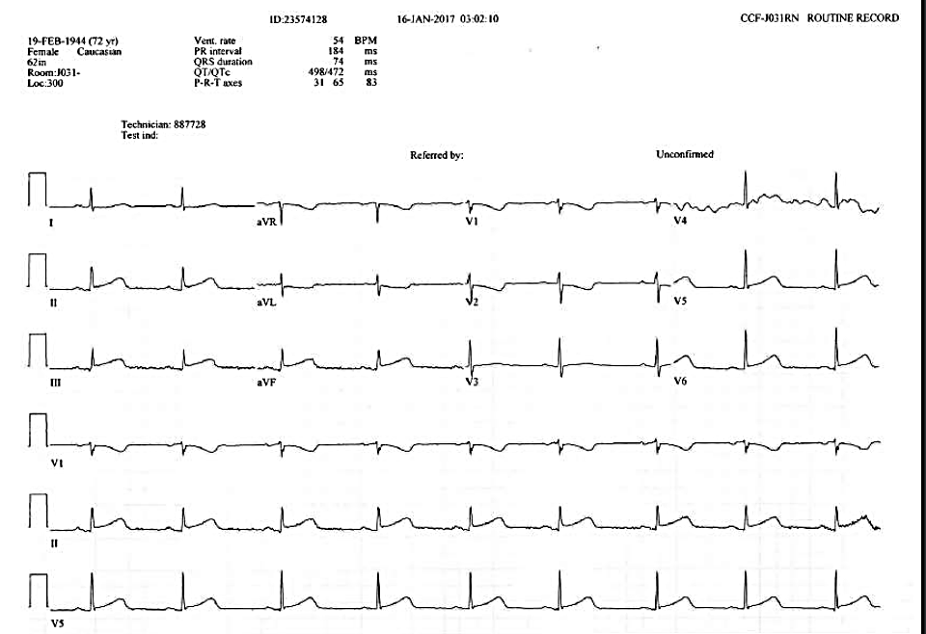
Notes:
More subtle
Inferior lead elevation; reciprocal changes in anterior
Consider right sided infarct

Slide 43

Checkpoint!
The ER RN can administer nitroglycerin without an MD order
True or False

Slide 44
Checkpoint!
Nitroglycerin is contraindicated in RV infarction
True or False

Slide 45
Checkpoint!
A patient was shown to be having an inferior infarct as per the MD. The patient’s BP pre-nitro was 125/80. The nurse administered nitroglycerin as per the MD order and the patient’s post-nitro BP was 80/40 and the patients chest pain is worse. What happened?
Notes:
- Up to 40% of inferior are complicated by RVI --- RIGHT SIDED INVOLVEMENT!
heart muscle, or myocardium, is perfused by the coronary artery system, and that the coronary arteries primarily fill with blood during diastole and are dependent upon pressures in the aorta immediately after the left ventricle contracts, one can easily understand that a drop in stroke volume as a result of lessened preload will eventually result in a drop in coronary artery filling pressures. If there is an obstruction in one or more of the coronary arteries, the blood supply to myocardial tissue will be further compromised
https://www.emsworld.com/article/10321209/recognition-and-treatment-right-ventricular-myocardial-infarction#:~:text=The%20traditional%20field%20treatment%20for,often%20referred%20to%20as%20MONA).

Slide 46
Checkpoint!
A patient was shown to be having an inferior infarct as per the MD. The patient’s BP pre-nitro was 125/80. The nurse administered nitroglycerin as per the MD order and the patient’s post-nitro BP was 80/40 and the patients chest pain is worse.
What should the nurse anticipate to improve the blood pressure?
a) Wait & monitor– as the nitro wears off it will improve
b) Administer another dose of nitroglycerin
c) Administer IV fluid bolus
d) Administer morphine
Notes:
Up to 40% of inferior are complicated by RVI

Slide 47
What is the preferred treatment for a right-sided infarction?
IV fluids to maintain perfusion/cardiac output
Avoid nitroglycerin, but nitroglycerin infusion may be used with extreme caution as it can be titrated
Avoid morphine, as it is also a vasodilator and will further reduce preload
Consider fentanyl for pain instead
Consider inotropes (dobutamine first choice)
Usual STEMI protocols:
  Oxygen for SpO₂ less than 94%
  ASA 180 mg chewed
  Thrombolytics; Anti-coagulants; Early revascularization (PCI)

Slide 48
CODE STEMI –
ER PROCESS
ENSURE THAT YOUR PRECEPTOR “RUNS THROUGH” THE STEMI PROCESS WITH YOU

Slide 49
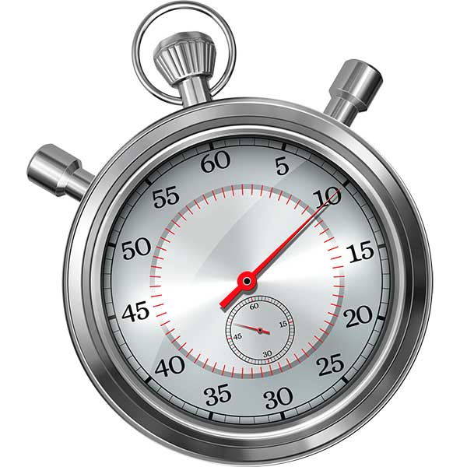
Door-to-first ECG time = 10 MINUTES
  Timely diagnosis of ST‐segment elevation myocardial infarction (STEMI) in the Emergency Department (ED) is made solely by ECG
  Do not need to wait for BW or troponins
  Obtaining this test within 10 minutes of ED arrival is critical to achieving the best outcomes
    RN to perform if lab delay

Slide 50
Door-to-first ECG time (goal <10 minutes)
Pt presents to ER with chest pain; signs direct patient to RPN desk (nursing station) (skips triage)
Pt moved into room 39, RPN or RN calls lab for STAT ECG - If not there within 5 minutes, RN to do ECG
If ECG positive STEMI moved to 28-3 (preferred) or other monitored bed, triage completed and code STEMI initiated
If negative, patient returned to triage to complete triage process
Review old ER chart (online) or call Health Records for old chart if any abnormalities on ECG for comparison
Notes:
To qualify for CODE STEMI, it must be within 12 hrs of symptom onset
Chest pain
Chest pain (with or without radiation)
Neck, jaw, shoulder, arm, or epigastric pain
Symptoms consistent with cardiac ischemia
short of breath,
diaphoresis,
pallor,
weakness,
nausea/vomiting
Tachycardia, bradycardia,
Caution in diabetics and women!!

Slide 51
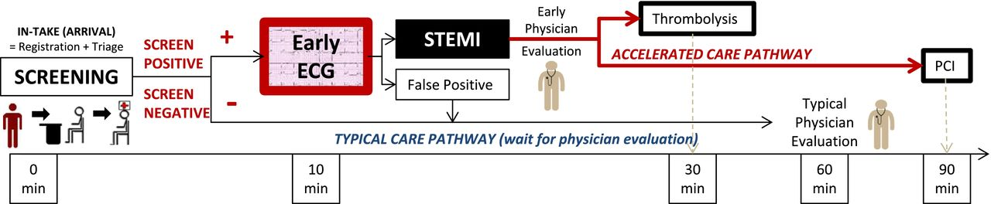
GOALS!
Eg. TNK
To qualify for PCI, the presentation must be within 12 hours of symptom onset
AND
Primary PCI can be delivered within 120 minutes
Notes:
PCI = percutaneous coronary intervention = performed at the OHI
These targets are provincially recorded. We must thoroughly document the time of each of our interventions.
presentation is within 12 hours of onset of symptoms and
primary PCI can be delivered within 120 minutes of the time when fibrinolysis could have been given

Slide 52
CODE STEMI PROCESS: When The Code is Called
Once code STEMI suspected, clear 28-3 and grab the Code STEMI box above sink by the med area in the ER
  Individual Code STEMI packages are in the box; if refills are needed, they are in a labelled binder in the file cabinet under the telemetry area in the ER
Follow the “Nurse Checklist: Potential Code STEMI” (in package)
  On confirmation by MD, RN to call OHI Nursing Coordinator
  Code will not be called overhead
  Must make sure the OHI Nursing Coordinator is notified of the Code STEMI and that the patient will be enroute
Obtain IV access!
Get an accurate patient weight if at all possible!

Slide 53
CODE STEMI
Chest pain protocol implemented (ECG, BW, IV access)
Code STEMI confirm by MD
MD/RN call UOHI for transfer
  Administer upon order
    TNK-weight adjusted IV bolus (unless contraindicated)
    ASA - already given when ECG done with protocol
    Plavix – 300 mg (75 years or younger)
    Unfractionated heparin - IV bolus 60 units/kg (max 4000 units)
    Then UFH infusion 12 units/kg/hour
Notes:
TNK - Follow reconstitution instructions included in package (10 mls sterile water and swirl gently to mix; bottle gives you a total of 50 mg/10 mls; dose is ordered in mg with easy ml reference)
Weight-adjusted IV bolus over 5 seconds (dosage is determined by MD on the drug order sheet in the package)
Drug is incompatible with dextrose – ensure no dextrose is in any part of the IV line tubing prior to drug administration (if so flush well in advance with saline)
Any remaining drug is discarded in appropriate container. Box can go to pharmacy for notification of need to refill. Pharmacy no longer takes the drug for credit.

Slide 54
CODE STEMI
Urgent transfer arranged to UOHI
Send documents -- ER notes, ECG, labs if resulted, Code STEMI Transfer Checklist (in package)
  Need MT # (ward clerk to get)
  Have ward clerk prepare package, have primary RN assist with care/package/transfer
Send patient with RN if going land ambulance
    DO NOT DELAY TRANSFER! – time is heart!

Slide 55
CODE STEMI PROCESS: Patient Transfer to OHI
Preferred mode of patient transfer to OHI is via Air ORNGE
  RN escort is not needed with ORNGE
  Do not delay patient transport if air is not available – can’t wait for land ORNGE!!!
  In such a case that air is not available, emergent local land ambulance with RN escort is needed (plan accordingly for the escort with primary RN and Clinical Resource as needed)
Complete “Code STEMI Transfer Checklist” to send with the patient (in Code STEMI package)
When the patient leaves for OHI, update OHI of departure time and expected arrival to their facility
  Fax any remaining patient results to OHI if/when available (get up-to-date fax number from on-call nursing coordinator in advance)

Slide 56
Reperfusion (particularly post-TNK)
If you are the RN escort on a patient being transferred with a STEMI be aware that:
This patient is UNSTABLE – high risk for cardiac arrest/other arrhythmias
Be prepared with transfer medications and know how to give them
Be prepared to see a lot of ectopy (ventricular irritability) in the form of PVCs, PACs, rhythm changes
The patient may flip into an accelerated idioventricular rhythm (AIVR)
Keep a close eye on the monitor!
Notes:
In the event of patient going into cardiac arrest (Vfib, Vtach) EMS will pull over, deliver shock, then re-route to nearest ER department
Meds: eg. nitro, morphine, heparin
Reperfusion: As the myocardium was deprived of O2, it had symptoms, as it receives a return of blood flow (post-TNK) myocardium may respond with arrhythmias.
Reperfusion arrhythmias originate as a consequence of the complex of cellular and humoral reactions accompanying the opening of coronary artery. These chemical mediators of reperfusion arrhythmias operate as modulators of cellular electrophysiology causing the complex changes at the level of ion channels.
The following arrhythmias are regarded also as markers of reperfusion: frequent premature ventricular complexes (> twofold increase in frequency within 90 minutes after the start of thrombolysis), a significant increase of episodes in non-sustained ventricular tachycardia, sinus bradycardia and probably also high-degree atrioventricular blocks. Reperfusion arrhythmias are an important noninvasive marker of successful restoration of blood flow. However, they are also a sign of reperfusion injury and a finding which may limit the favourable effect of reperfusion. Ventricular tachycardia and ventricular fibrillation remain the most important causes of sudden death following spontaneous restoration of antegrade flow
As a typical reperfusion arrhythmia is considered an early (within 6 hours after start of thrombolysis), frequent (> 30 episodes/hour) and repetitive (occurring during > 3 consecutive hours) accelerated idioventricular rhythm (AIVR).

Slide 57
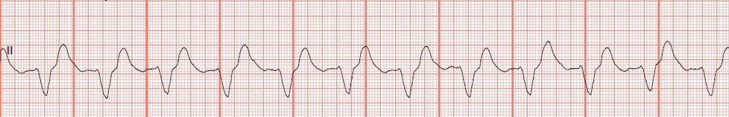
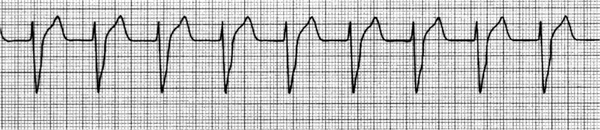
Accelerated Idioventricular Rhythm (AIVR)
Notes:
Accelerated = faster than normal. Normal ventricular rate = 20-40 bpm; AIVR rate 40-120 bpm, faster than 120 → ventricular tachycardia (follow ACLS)
Idioventricular = meaning only affecting ventricles
AIVR is usually benign, usually does not require treatment. HR is usually tolerated well because it is within normal rates; less symptomatic.

Slide 58
STEMI PROCESS – ICU

Slide 59
NEW ST ELEVATION = NOTIFY MD
ASSESS PATIENT (VS, CHEST PAIN, VERIFY TELEMETRY WIRE PLACEMENT)
PERFORM ECG
IF ST ELEVATION SEEN ON ECG, NOTIFY MD
IF MD UNABLE TO COME SEE ECG, ASK ER MD TO VIEW
FOLLOW MD DIRECTION
(NO OFFICIAL IN-HOUSE STEMI PROTOCOL)
  Likely will follow ER STEMI protocol; ask ER/ICU charge RN to assist
Notes:
Be aware that sometimes lead placement, resistance, movement, etc can alter the waveform – telemetry is considered non-diagnostic.
The only way to get a “diagnostic” view is through an ECG.
Remember it has to have 2 leads that look at the same area (contiguous).
Remember, certain other conditions may cause ST changes (eg. pericarditis – common with H1N1, COVID-19)

Slide 60
STEMI TEST

Slide 61
Code STEMI test
Your patient with chest pain and related symptoms (suggestive of cardiac ischemia) reports timeframe of 72 hrs since symptom onset.
Are Code STEMI criteria met based on this knowledge alone?
Yes
No
Notes:
12 hrs!

Slide 62
Code STEMI test
2. Your Code STEMI patient is awaiting OHI transfer via air ORNGE; ORNGE calls back and states that air is unavailable. What is your remaining transfer option?
Awaiting land ORNGE
Immediate local land ambulance with RN escort
Local land ambulance without an escort
Private transfer by patient family

Slide 63
Code STEMI test
3. EMS has patched in a STEMI patient. The MD confirms a Code STEMI on ambulance arrival. Prior to transferring the onto the stretcher in 28-3, what should you do?
Start a saline lock on the EMS stretcher
Direct family to the family room
Zero the stretcher scale to be able to weigh immediately
Call for the patient’s old chart from Health Records

Slide 64
Code STEMI test
4. What does contiguous mean?
Lead views that look at opposite areas of the heart
Lead views that are numerically beside each other (e.g. I is next to II)
Lead views that look at the same areas of the heart

Slide 65
Code STEMI test
5. You have remaining TNK leftover after the MD has given the ordered dose to your Code STEMI patient. You should promptly discard of this leftover drug into a blue pharmaceutical waste container.
True
False

Slide 66
Code STEMI test
6. A Code STEMI is called and there are no packages in the Code STEMI box. Where can you quickly find more prepared packages?
Call the clerk to prepare one immediately
Medication room in ICU
Code Stroke box
In a labelled binder in the file cabinet beside the charge nurse desk in the ER

Slide 67
Code STEMI test
7. The nurse recognizes that the following are signs of a STEMI:
A) ST elevation in 2 contiguous leads
B) New left bundle branch block
C) Chest pain less than 12 hours
D) All of the above

Slide 68
References
University of Ottawa Heart Institute, Renfrew County Paramedic Services, Pembroke Regional Hospital. (n.d.). Code STEMI protocol: Urgent transfer to UOHI for TNK facilitated PCI.
PRH Clinical Skills. “Tenecteplase for acute myocardial infarction.”
PRH Policy & Procedure (policy medical)
  Code STEMI – Facilitated Percutaneous Coronary Intervention
https:lifeinthefastlane.com/ecg
https://www.ena.org/docs/default-source/resource-library/practice-resources/tips/right-side-ecg.pdf?sfvrsn=836f00e6_8
http://cdn.esa.act.gov.au/wp-content/uploads/17-15-LEAD-ECG.pdf
https://www.ncbi.nlm.nih.gov/books/NBK2214/table/A65/?report=objectonly
https://www.ena.org/docs/default-source/resource-library/practice-resources/tips/right-side-ecg.pdf?sfvrsn=836f00e6_8
https://www.cablesandsensors.com/pages/12-lead-ecg-placement-guide-with-illustrations
http://jaha.ahajournals.org/content/6/3/e003528

