Slide 1
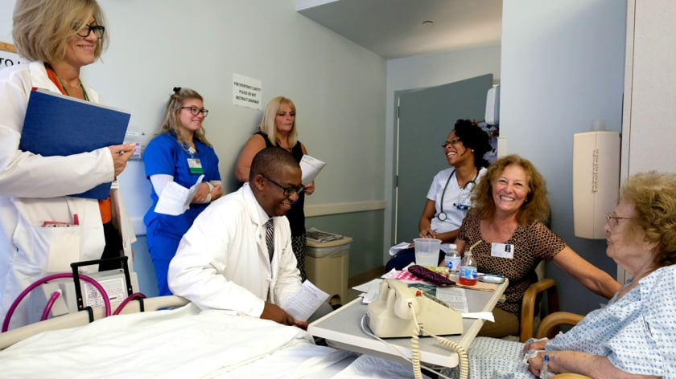

ICU Structured Interdisciplinary Bedside Rounding
Developed Jan. 2020

Slide 2
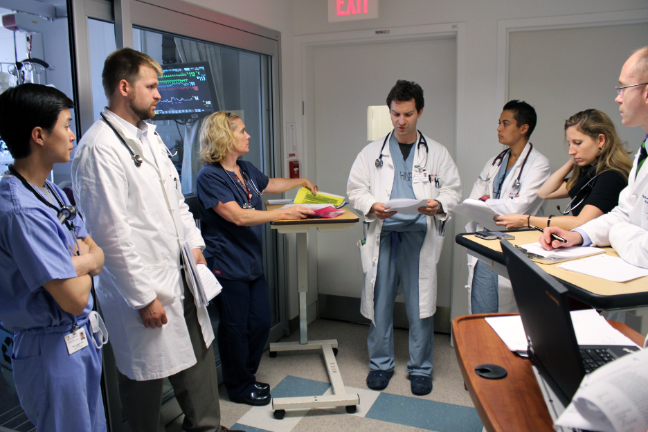
Outline
What is Structured Interdisciplinary Bedside Rounding (SIBR)?
Why do we do it?
Structure of our team
Our process and tools.

Slide 3
What is Structured Interdisciplinary Bedside Rounding?
A care model in which “disciplines come together, informed by their clinical expertise, to coordinate patient care, determine care priorities, establish daily goals, and plan for potential transfer or discharge.”
Our Team Members:
-Physician | -Patient Care Lead
-Nurse | -Respiratory Therapist
-Pharmacist | -Social Worker
-Dietician | -Physiotherapist
-Occupational Therapist | -Patient and Family

Slide 4
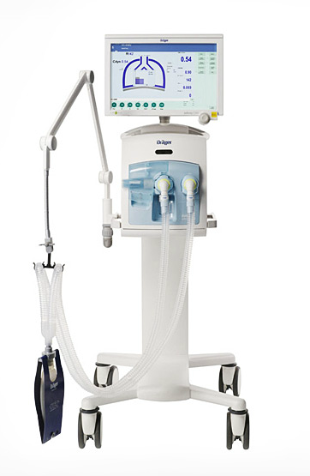
We Do It For Our Patients!
Increased focus on best practice initiatives (VAP prevention, central line infection prevention, blood glucose control, antimicrobial stewardship, ABCDE Bundle etc.) (3)
Decrease in nosocomial infections (4)
-ventilator associated pneumonia
-blood stream infections
-urinary catheter infections
Decreased ventilator days, length of stay, and mortality (1, 2)

Slide 5

We Do It For Our Patients!
Higher measures of nurse-perceived collaboration in an ICU correlate to a decrease in death or readmission on transfer out of ICU (5)

Slide 6
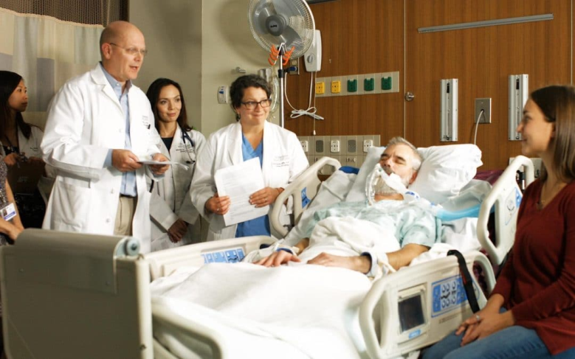
We Do It For Our Patient’s Families!
When given the choice, between 85
and 100% of families prefer to
be present for rounds (6)
Benefits to our patient’s families:
-Perception of receiving more information, consistent information, and receiving information in a more timely fashion (6)
-Increased satisfaction with frequency of communication and better understanding of the care plan (6)
-Decrease in the incidence of anxiety, depression, and posttraumatic stress in family members (6)
Notes:
-Those choosing not to attend often feel that the volume of information would cause them more stress or confusion, but for the majority their need for information is greater than the stress imposed by participating in rounds.

Slide 7

But What About The Down Side?
Participation on rounds can cause fear, anxiety, and confusion for some family members.
Some strategies for facilitating a positive family experience in rounds include:
  Introducing the idea of family presence on rounds during the first meeting with the family.
  Explaining family presence on rounds again prior to the first rounding experience.
  Having the name and role of each team member easily visible and introduced at the beginning of rounds.
  Providing a summary without medical jargon prior to rounds being complete.

Slide 8
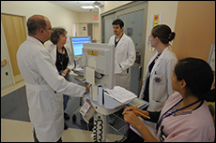
We Do It For Us!
Shorter total rounding time and interruption time (7)
Decreased information gaps and breaks in communication (8)
Equal allocation of time for patients at start and end of rounds.
  Without structured tools used for rounds, patients discussed later in the rounding session are subject to “end of round time compression” (8)

Slide 9

We Do It For Us!
Increased understanding of care plan and daily goals (9, 10)
Direct relationship between organizational structures such that foster nurse-physician collaboration and hiring and retention of nurses (11)
Improved resource utilization and decreased cost
Improved provider-family member relationships

Slide 10
The Structure of our Team
Physician – 2 on days, 1 overnight
Patient Care Lead (Charge Nurse) – 1 on days, 1 on nights
Most Responsible Nurse – 13+1 on days and nights
Respiratory Therapist – 2 on days, 2 on nights for ICU
Pharmacist – 1 on days, limited weekend coverage
Social Worker – Part-time coverage 3 days per week
Physiotherapist – 1 on days, limited weekend coverage
Occupational Therapist – Consulted as needed

Slide 11
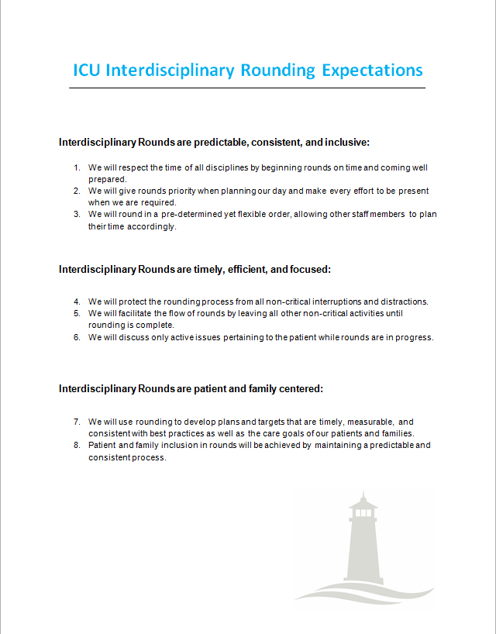
Our Expectations
Interdisciplinary Rounds are predictable, consistent, and inclusive:
We will respect the time of all disciplines by beginning rounds on time and coming well prepared.
We will give rounds priority when planning our day and make every effort to be present when we are required.
We will round in a pre-determined yet flexible order, allowing other staff members to plan their time accordingly.

Slide 12
Our Expectations
Interdisciplinary Rounds are timely, efficient, and focused:
We will protect the rounding process from all non-critical interruptions and distractions.
We will facilitate the flow of rounds by leaving all other non-critical activities until rounding is complete.
We will discuss only active issues pertaining to the patient while rounds are in progress.

Slide 13
Our Expectations
Interdisciplinary Rounds are patient and family centered:
We will use rounding to develop plans and targets that are timely, measurable, and consistent with best practices as well as the care goals of our patients and families.
Patient and family inclusion in rounds will be achieved by maintaining a predictable and consistent process.

Slide 14
Our Process
Bullet Rounds:
When: Monday-Friday @ 0830
Where: ICU Conference
What: Brief (1-minute per patient) meeting to run the current patient list and discuss goals/needs.
Who: Led by Charge Nurse, Attended by Physician, UCC, RRT, Pharmacist, PT, OT, SW, Dietician
Structured Interdisciplinary Bedside Rounds:
When: Immediately following Bullet Rounds
Where: In ICU
What: In-depth discussion of current patient condition and plan of care.
Who: Primary nurse, Physician, and RRT if patient has respiratory needs. May include other disciplines based on need/availability.

Slide 15
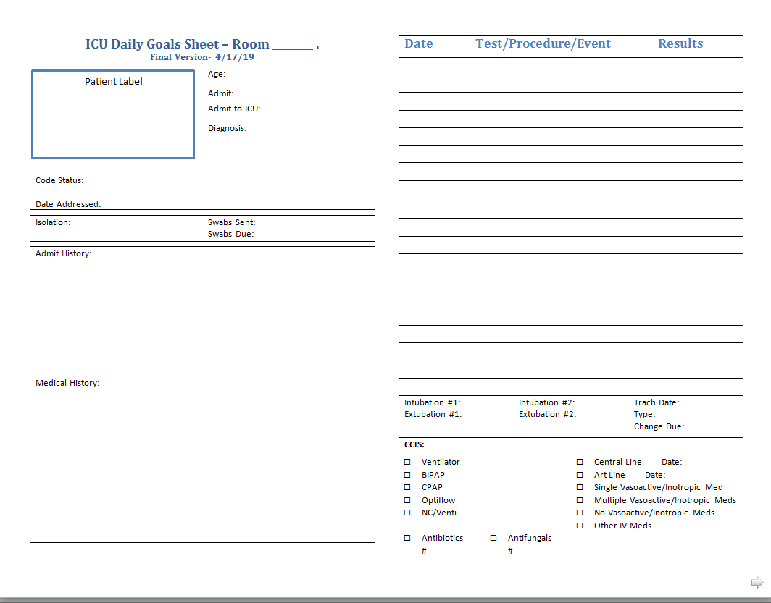
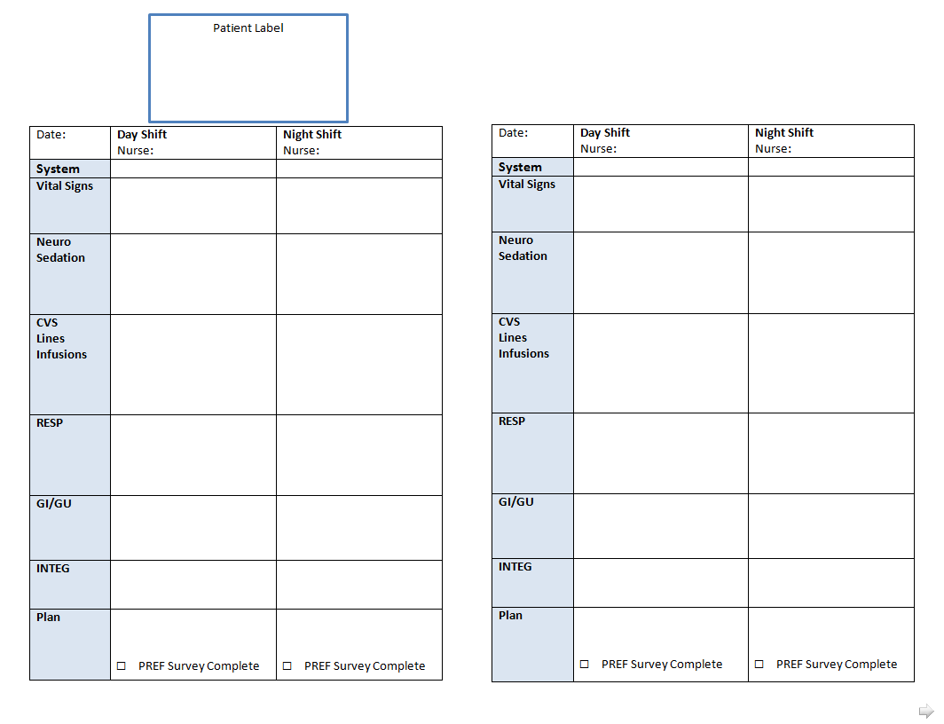
Our Tools
Daily Goals Sheet

Slide 16
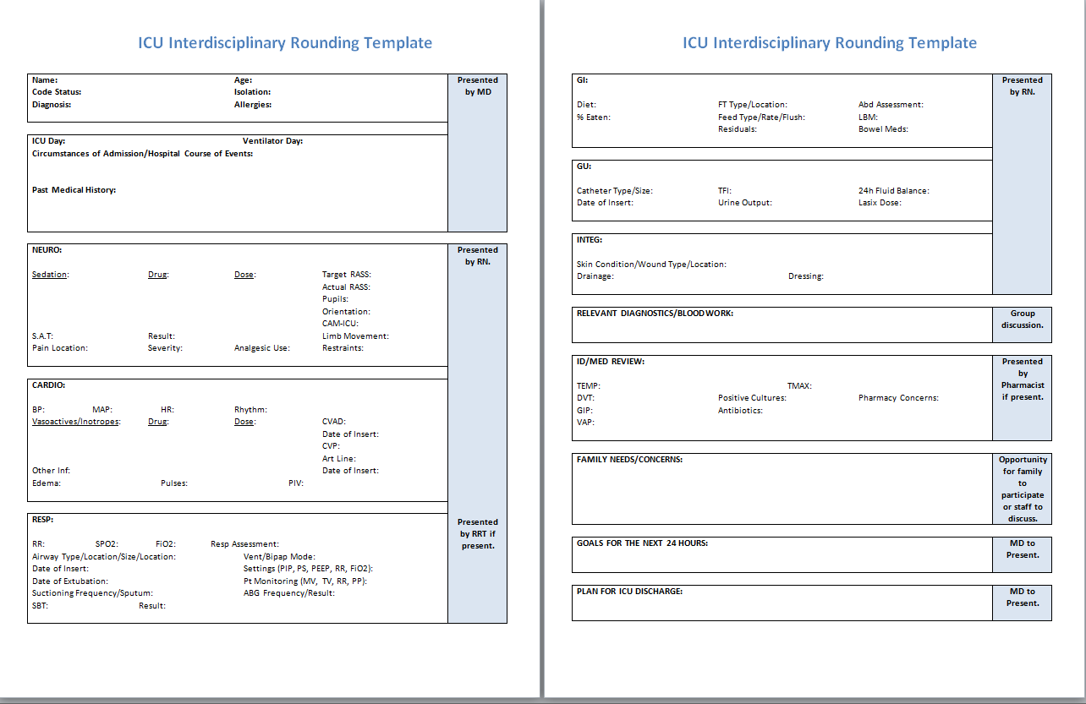
Our Tools
Interdisciplinary Rounding Template

Slide 17
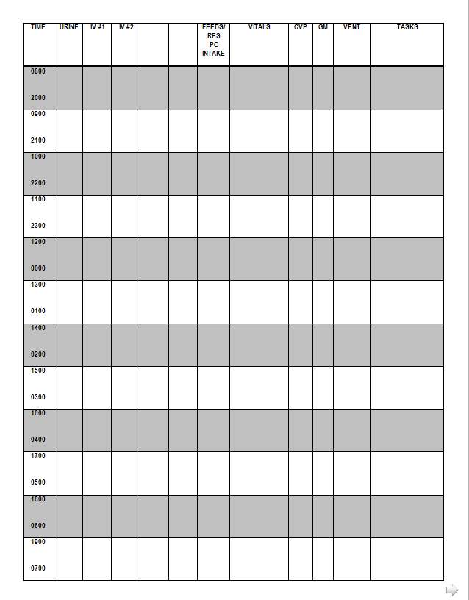
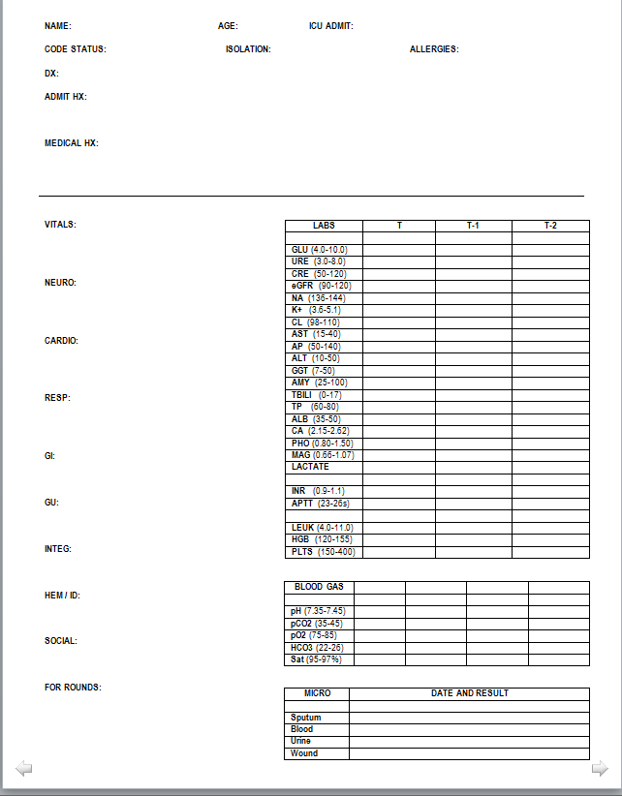
Our Tools
Organization Sheet

Slide 18
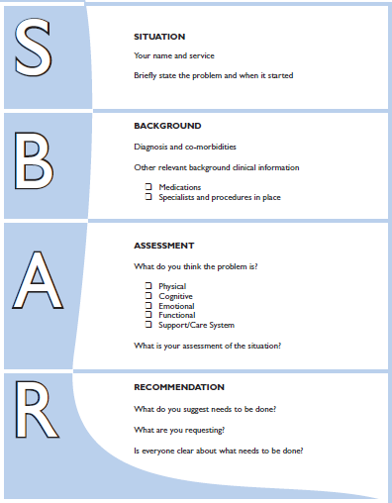
Our Tools
SBAR Communication Tool
Situation – your name, name of the patient you are calling about, what you are calling about.
Background – diagnosis and co-morbidities, other clinically relevant background clinical information.
Assessment – what you think the problem is, subjective/objective assessment of the situation.
Recommendation – what you suggest the patient needs, what you are requesting.

Slide 19
Our Tools
SBAR Communication Tool
Situation – Hello, this is and I am calling you regarding Mr. Jones in room 9. I am unable to maintain his MAP greater than 65mmHg as ordered.
Background – He was admitted last evening with pneumonia and sepsis after being unwell for several days at home. He has a history of hypertension at home but his antihypertensives have been on hold since admission.
Assessment – I have had to increase his levophed from 6mcg/min to 15mcg/min and his CVP on his am assessment was 4. He has Ringers running at 50ml/hr currently and his urine output for the last 2 hours has been less than 30 ml/h.
Recommendation – I am concerned that the patient is dry and wonder if he needs a fluid bolus?
An SBAR Nurse Call Fail

Slide 20
References
Louzon, P., Jennings, H., Mahmood, A., & Kraisinger, M. (2017). Impact of pharmacist management of pain, aggitation, and delerium in the intensive care unit through participation in multidisciplinary bundle rounds. American Society of Health-System Pharmacists, 74(4), 253-262.
Kim, M.K., Bernato, A.E., Angus, D.C., Fleisher, L.F., & Kahn, J.M. (2010). Effect of multidisciplinary care teams on intensive care unit mortality. Arch Internal Medicine, 170(4), 369-376.
Wilson, F.E., Newman, A., & Ilari, S. (2009). Innovative solutions: Optimal patient outcomes as a result of multidisciplinary rounds. Dimensions of Critical Care Nursing, 28(4), 171-173.
Jain, M., Miller, L., King, D., & Berwick, D.M. (2006). Decline in ICU adverse events, nosocomial infections and cost through a quality improvement initiative focusing on teamwork and culture change. Quality Safe Health Care, 15, 235-239.
Baggs, J.G, Schmitt, M.H., Mushlin, A.I., Mitchell, P.H., Eldredge, D.H., Oakes, D., &Hutson, A. (1999) Association between nurse-physician collaboration and patient outcomes in three intensive care units. Critical Care Medicine, 27 (2), 1991-1998.
Davidson, J.E. (2013). Family Presence on Rounds in Neonatal, Pediatric, and Adult Intensive Care Units. Annals of the American Thoracic Society, 10(2), 152-156.
Abraham, J., Kannampallil, T., Patel, V.L., Patel, B., & Almoosa, K.F. (2016). Impact of structured rounding tools on time allocation during multidisciplinary rounds: An observational study. JMIR Human Factors, 3(2).
Cao, V., Tan, L. ., Horn, F., Bland, D., Giri, P., Maken, K., Cho, N., Scott, L., Dinh, V. A., Hidalgo, D., & Nguyen, H. B. (2018) Patient-centered structred interdisciplinary bedside rounds in the medical ICU. Critical Care Medicine, 2018(46), 85-92.
Gausvik, C., Lautar, A., Miller, L., Harini, P. & Schlaudecker, J. (2015) Structured nursing communication on interdisciplinary acute care teams improves perceptions of safety, efficiency, understanding of care plan and teamwork as well as job satisfaction. Journal of Multidisciplinary Healthcare, 2015(8), 33-37.
Pronovost, P., Berenholtz, s. Dorman, T., Lipsett, P.A., Simmonds, T., & Haraden, C. (2003). Improving communication in the ICU using daily goals. Journal of Critical Care, 18(2), 71-75.
Miller, P. A. (2001). Nurse-physician collaboration in an intensive care unit. American Journal of Critical Care, 10(5), 341-350.
Notes:
Author, A. A., Author, B. B., & Author, C. C. (Year). Title of article. Title of Periodical, volume number(issue number), pages. https://doi.org/xx.xxx/yyyy

